Slide 1
DESIGN OF MACHINE ELEMENTS 5TH SEMESTER MECHANICAL ENGINEERING
Mr. Kalia Sethi
Dept. of Mechanical engineering
UCPES Berhampur

Slide 4
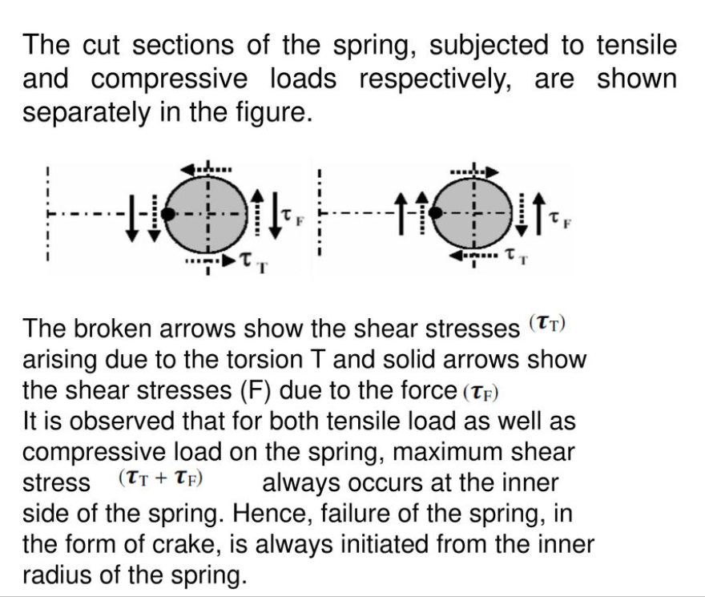

Slide 5
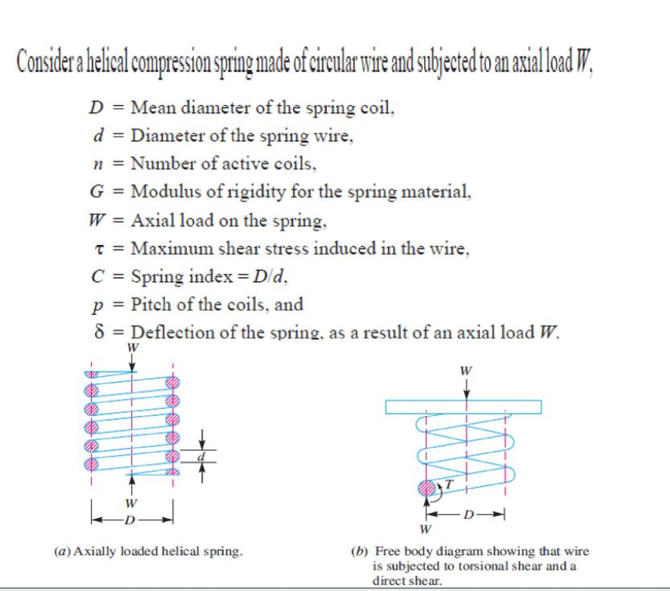

Slide 7
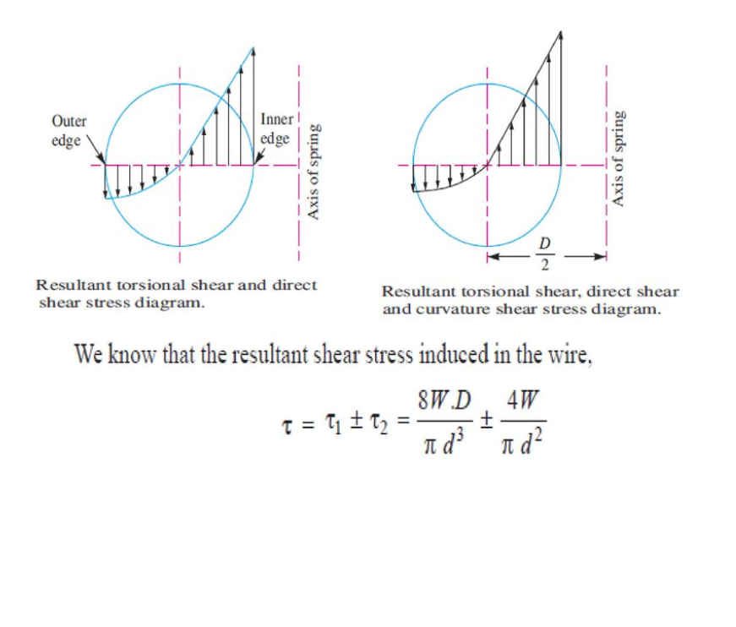

Slide 8
